Slide 1

OPTIMISING HEALTHCARE RESOURCES WITH MACHINE LEARNING
CHAN YI XUAN
JEROME CHEW
JORDAN LOW
TERESA ZHANG
U2010972F
U2021304E
U2010804E
U2022886C
MINISTRY OF HEALTH
SINGAPORE

Slide 2




CONTENTS
JEROME
SEVERITY PREDICTION MODEL
BUSINESS PROBLEM
OUR
SOLUTION
ICU ADMISSION MODEL
1E4D76
F25F66
F68D92
221E20
777676
D8D8D8
Notes:
Our presentation will proceed in the following order: I will kick start the sharing by presenting our business problem, followed by Jordan and Casslyn who will present our proposed solution. Brandon will then go through our data preparation process, and Yixuan will conclude by sharing more about our prediction models. With that, let’s move on to the business problem.

Slide 3
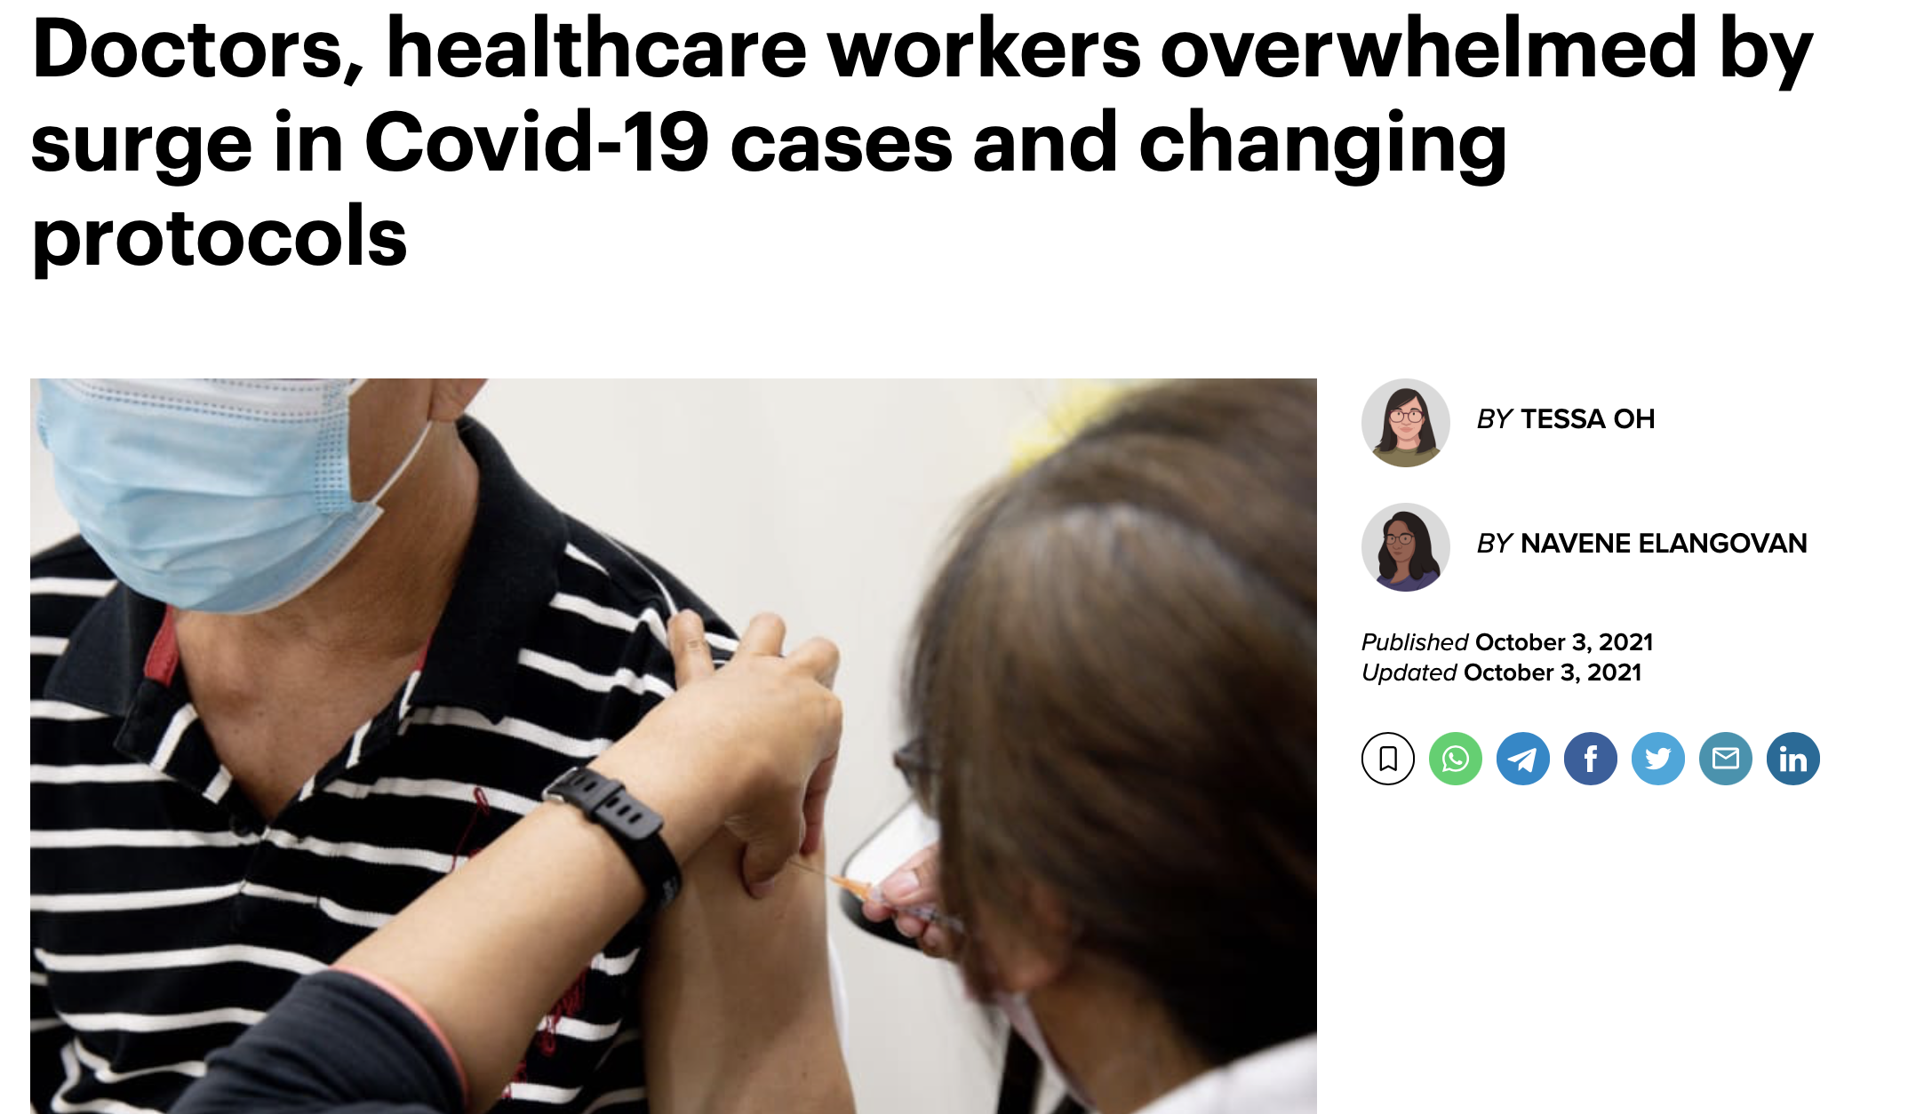

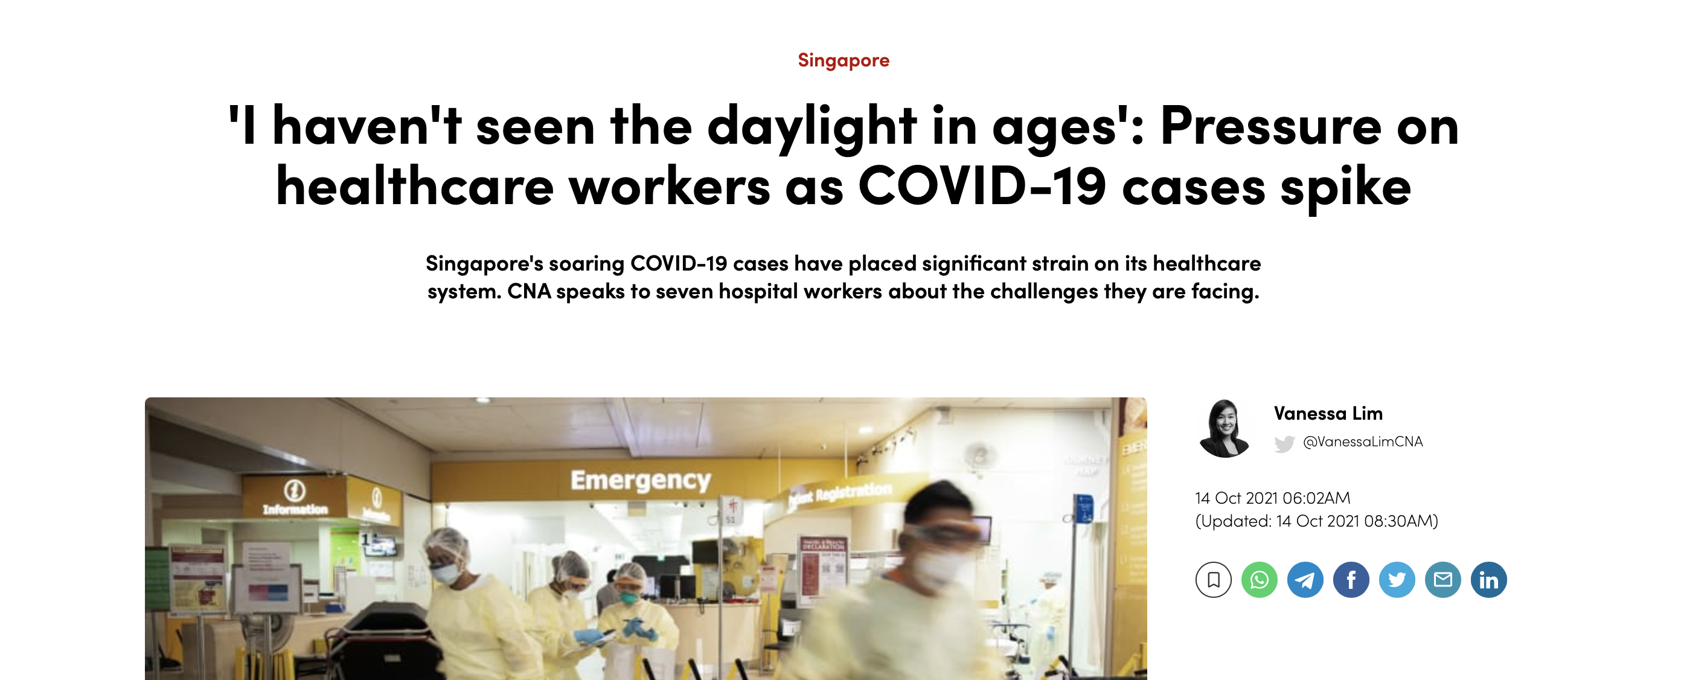
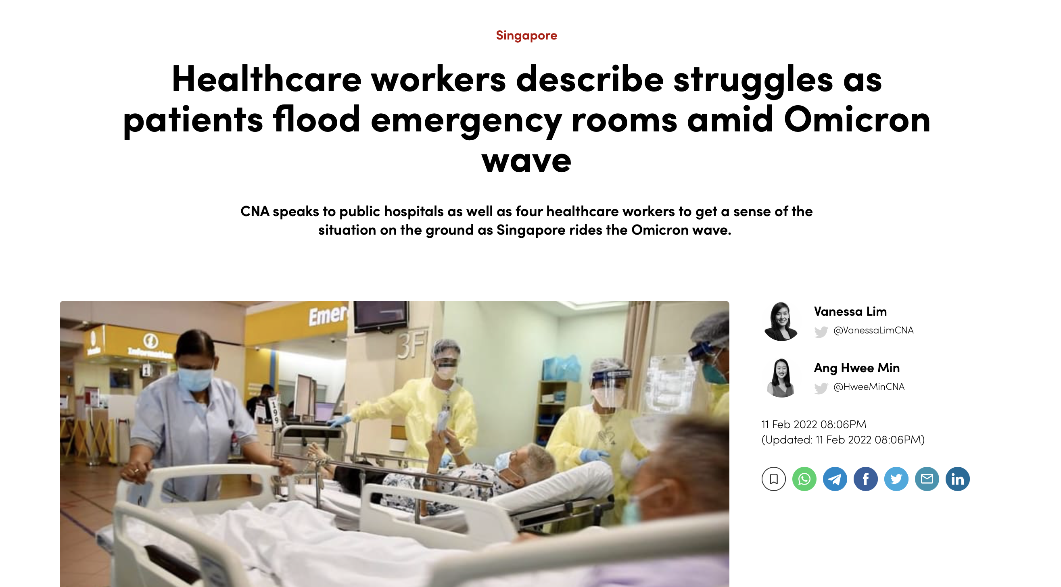

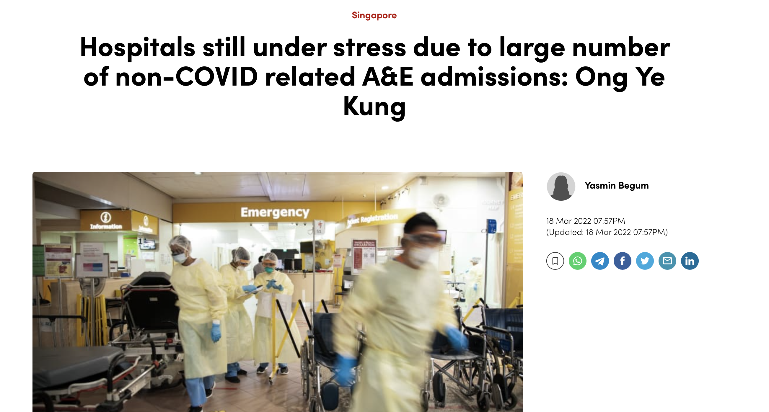
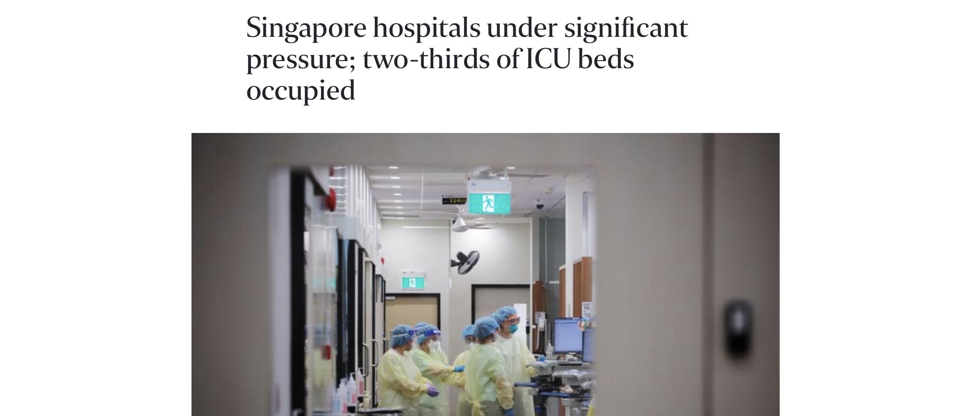

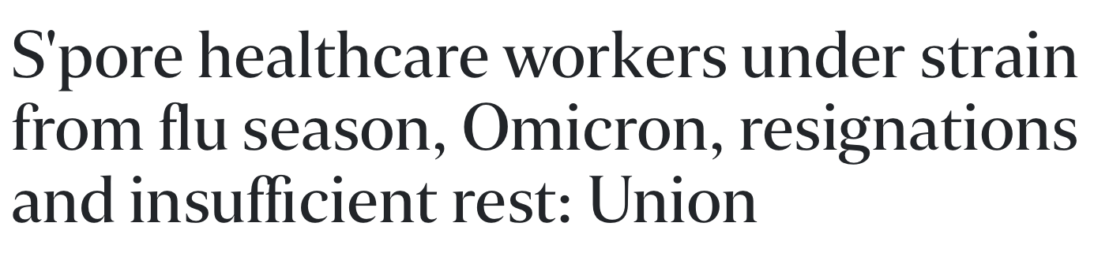
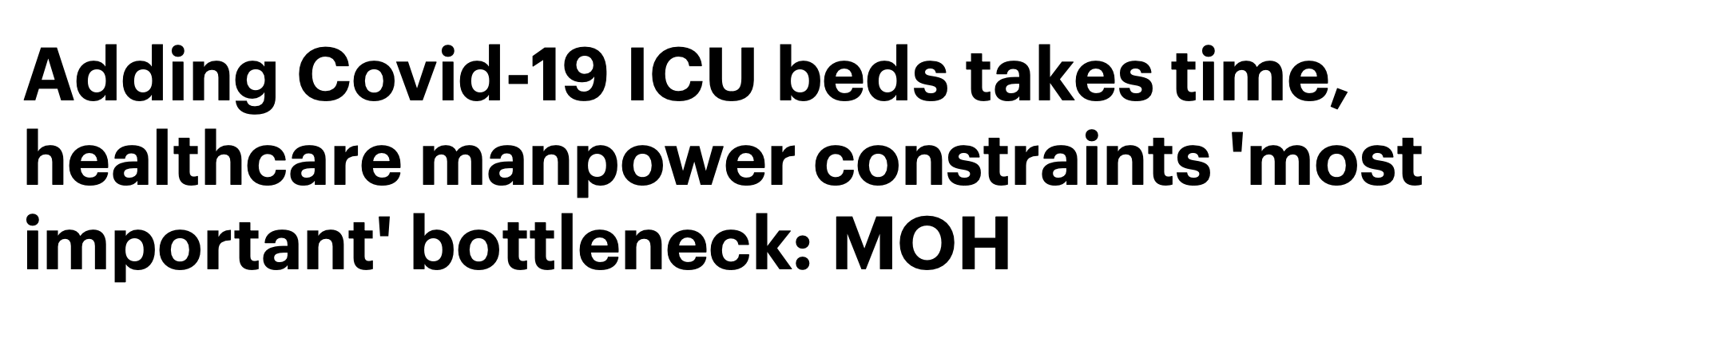

BUSINESS PROBLEM
JEROME
INTRODUCTION
BUSINESS PROBLEM
OUR
SOLUTION
SEVERITY
PREDICTION
MODEL
ICU ADMISSION MODEL
MINISTRY OF HEALTH
SINGAPORE
EC1B24
F25F66
F68D92
221E20
777676
D8D8D8

Slide 4
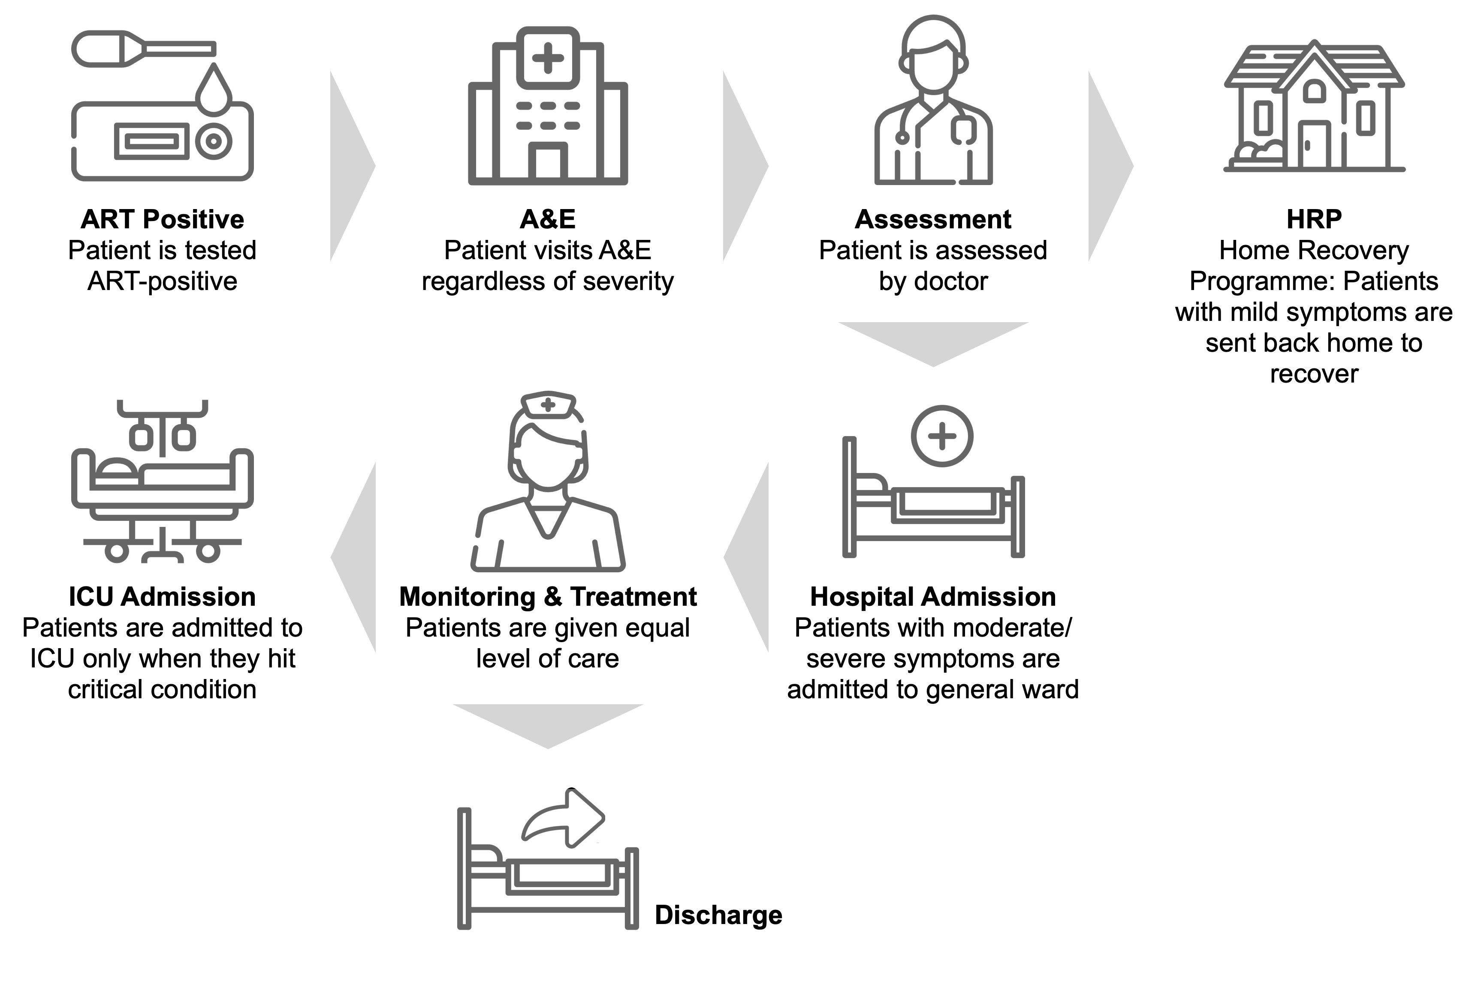
BUSINESS PROBLEM
JEROME
PATIENT ROADMAP
BUSINESS PROBLEM
OUR
SOLUTION
SEVERITY
PREDICTION
MODEL
ICU ADMISSION MODEL
MINISTRY OF HEALTH
SINGAPORE

Slide 5
BUSINESS PROBLEM
JEROME
PATIENT ROADMAP
BUSINESS PROBLEM
OUR
SOLUTION
SEVERITY
PREDICTION
MODEL
ICU ADMISSION MODEL
MINISTRY OF HEALTH
SINGAPORE

Slide 6
BUSINESS PROBLEM
JEROME
PATIENT ROADMAP
BUSINESS PROBLEM
OUR
SOLUTION
SEVERITY
PREDICTION
MODEL
ICU ADMISSION MODEL
MINISTRY OF HEALTH
SINGAPORE

Slide 7
BUSINESS PROBLEM
JEROME
PATIENT ROADMAP
BUSINESS PROBLEM
OUR
SOLUTION
SEVERITY
PREDICTION
MODEL
ICU ADMISSION MODEL
MINISTRY OF HEALTH
SINGAPORE

Slide 8
BUSINESS PROBLEM
JEROME
PATIENT ROADMAP
BUSINESS PROBLEM
OUR
SOLUTION
SEVERITY
PREDICTION
MODEL
ICU ADMISSION MODEL
MINISTRY OF HEALTH
SINGAPORE

Slide 9
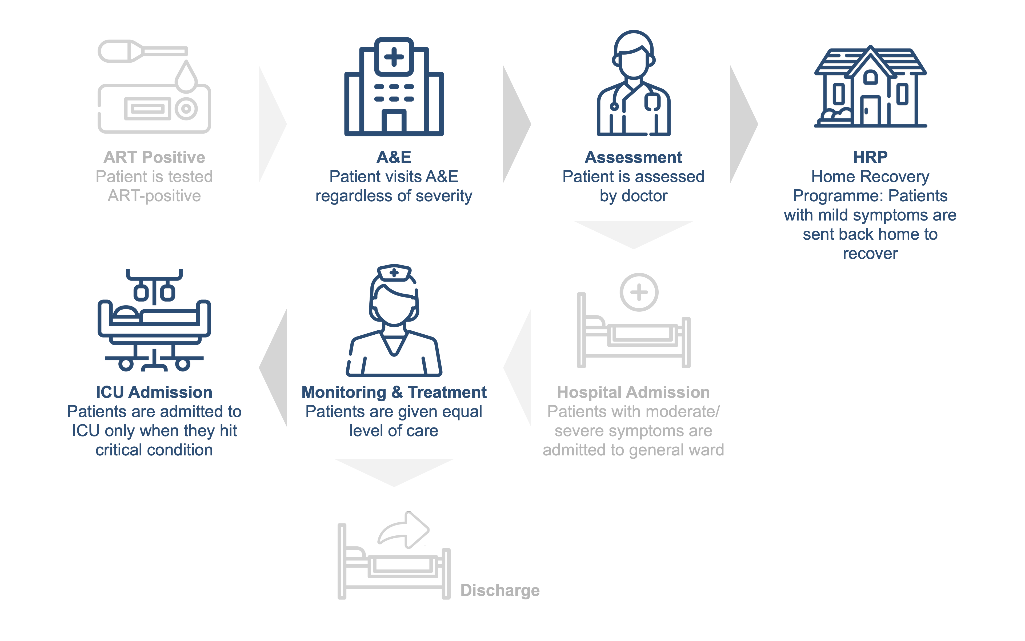
BUSINESS PROBLEM
JEROME
PATIENT ROADMAP
ISSUE 1
BUSINESS PROBLEM
OUR
SOLUTION
ISSUE 2
SEVERITY
PREDICTION
MODEL
ICU ADMISSION MODEL
MINISTRY OF HEALTH
SINGAPORE

Slide 10
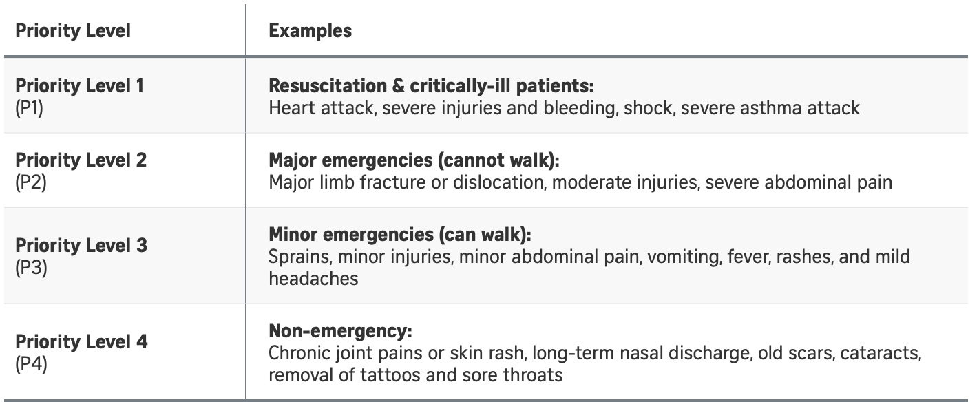
BUSINESS PROBLEM
JEROME
ISSUE 1: OVERCROWDING AT A&E
BUSINESS PROBLEM
OUR
SOLUTION
SEVERITY
PREDICTION
MODEL
ICU ADMISSION MODEL
(Woon, 2022)
MINISTRY OF HEALTH
SINGAPORE
Notes:
Currently, the procedure for any patients, including COVID-19 positive, who visit the A&E are first being classified into the following 4 levels of priority:
After they have been classified, all patients, regardless of priority levels, will have to see a doctor before being discharged. This creates an inefficiency in hospital resources as time and resources are required to address patients of low priority which takes the attention away from high priority patients who have a greater need for medical care.

Slide 11



BUSINESS PROBLEM
JEROME
ISSUE 1: OVERCROWDING AT A&E
BUSINESS PROBLEM
OUR
SOLUTION
SIX
HOURS
SEVERITY
PREDICTION
MODEL
Waiting Time
ICU ADMISSION MODEL
P1, P2
P3, P4
(Woon, 2022)
MINISTRY OF HEALTH
SINGAPORE
Notes:
According to an A&E doctor, two-thirds of COVID-19 positive patients who visit the A&E fall into priority levels 3 and 4. Due to the high number of patients who do not require medical attention but still visit the A&E, waiting time have ballooned to over 6 hours (Woon, 2022). One-third of COVID-19 positive patients are then held back in receiving more timely medical attention.

Slide 12
BUSINESS PROBLEM
JEROME
ISSUE 1: OVERCROWDING AT A&E
BUSINESS PROBLEM
OUR
SOLUTION
64%
89%
SEVERITY
PREDICTION
MODEL
ICU ADMISSION MODEL
% Occupancy of ICU Beds
% Occupancy of Isolation Beds
(Teo, 2021)
MINISTRY OF HEALTH
SINGAPORE
EC1B24
F25F66
F68D92
221E20
777676
D8D8D8

Slide 13
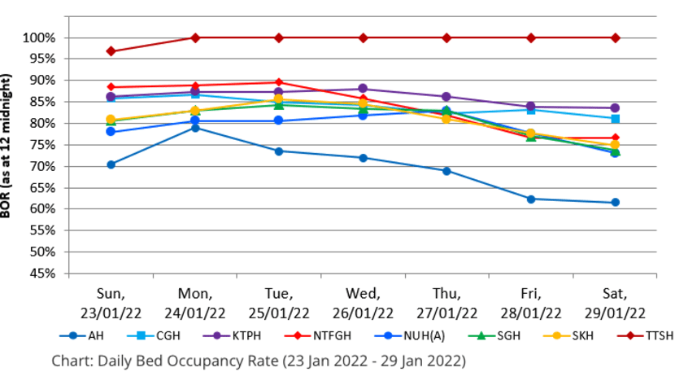
BUSINESS PROBLEM
JEROME
ISSUE 1: OVERCROWDING AT A&E
BUSINESS PROBLEM
OUR
SOLUTION
SEVERITY
PREDICTION
MODEL
ICU ADMISSION MODEL
(MOH, 2022)
MINISTRY OF HEALTH
SINGAPORE
Notes:
https://www.channelnewsasia.com/singapore/healthcare-workers-describe-struggles-patients-flood-emergency-rooms-amid-omicron-wave-2492571

Slide 14
BUSINESS PROBLEM
JEROME
ISSUE 2: STANDARDISED LEVEL OF CARE
BUSINESS PROBLEM
Lack of care differentiation between patients who have been admitted to hospitals
Often hard for healthcare workers to tell who will need ICU care at the early stage of disease
OUR
SOLUTION
SEVERITY
PREDICTION
MODEL
(French, et al., 2022)
ICU ADMISSION MODEL
MINISTRY OF HEALTH
SINGAPORE
Notes:
there is a lack of care differentiation between patients who have been admitted into the hospitals. Patients are only admitted into ICU when they hit critical condition when it potentially might have been too late. However, it is often hard for healthcare workers to tell who will need ICU care at the early stage of disease or presentation to the hospital (French, et al., 2021).

Slide 15

BUSINESS PROBLEM
JEROME
ISSUE 2: STANDARDISED LEVEL OF CARE
BUSINESS PROBLEM
OUR
SOLUTION
SEVERITY
PREDICTION
MODEL
ICU ADMISSION MODEL
Pre-Pandemic
During Pandemic
(Ang and Lim, 2022)
MINISTRY OF HEALTH
SINGAPORE
Notes:
Patients who are more severe are further deprived from adequate medical attention due to manpower crunch in our hospitals. Before the pandemic, nurses are taking care of 6 patients each. Just this year, the number has increased to 12 patients per nurse.

Slide 16
BUSINESS PROBLEM
JEROME
ISSUE 2: STANDARDISED LEVEL OF CARE
BUSINESS PROBLEM
OUR
SOLUTION
Patients who have more severe symptoms are not receiving the additional level of care that they require.
SEVERITY
PREDICTION
MODEL
ICU ADMISSION MODEL
MINISTRY OF HEALTH
SINGAPORE
Notes:
Patients who are more severe are further deprived from adequate medical attention due to manpower crunch in our hospitals. Before the pandemic, nurses are taking care of 6 patients each. Just this year, the number has increased to 12 patients per nurse.

Slide 17
BUSINESS PROBLEM
JEROME
BUSINESS PROBLEM
Issue 1: Overcrowding
at A&E
Issue 2: Standardised
Level of Care
OUR
SOLUTION
SEVERITY
PREDICTION
MODEL
BUSINESS PROBLEM
Hospital Resources are not allocated to the patients that need it the most
ICU ADMISSION MODEL
MINISTRY OF HEALTH
SINGAPORE
Notes:
Patients who are more severe are further deprived from adequate medical attention due to manpower crunch in our hospitals. Before the pandemic, nurses are taking care of 6 patients each. Just this year, the number has increased to 12 patients per nurse.

Slide 18
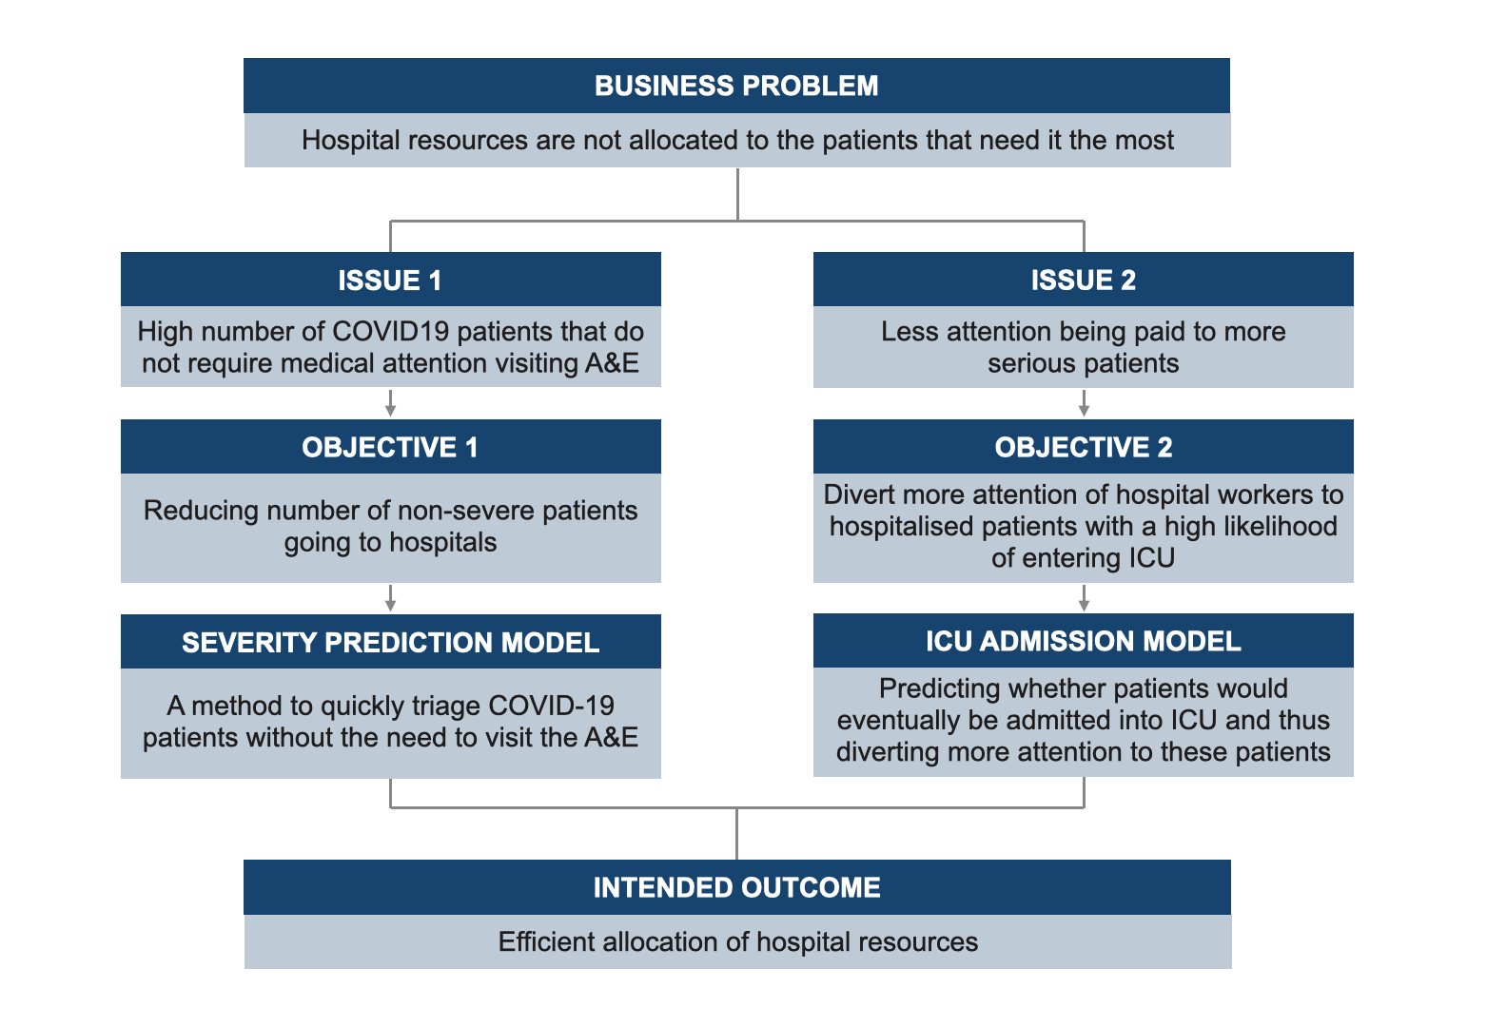
OUR SOLUTION
YI XUAN
APPROACH
BUSINESS PROBLEM
OUR
SOLUTION
SEVERITY
PREDICTION
MODEL
ICU ADMISSION MODEL
MINISTRY OF HEALTH
SINGAPORE
EC1B24
F25F66
F68D92
221E20
777676
D8D8D8
Notes:
Without a doubt, we are currently living through extraordinary times. COVID-19 has plagued our world for nearly 2 years - earning it the title as the most serious global crisis in the last 75 years due to its wide ranging impacts and repercussions.

Slide 19
OUR SOLUTION
YI XUAN
APPROACH
BUSINESS PROBLEM
OUR
SOLUTION
SEVERITY
PREDICTION
MODEL
ICU ADMISSION MODEL
MINISTRY OF HEALTH
SINGAPORE
EC1B24
F25F66
F68D92
221E20
777676
D8D8D8
Notes:
Without a doubt, we are currently living through extraordinary times. COVID-19 has plagued our world for nearly 2 years - earning it the title as the most serious global crisis in the last 75 years due to its wide ranging impacts and repercussions.

Slide 20
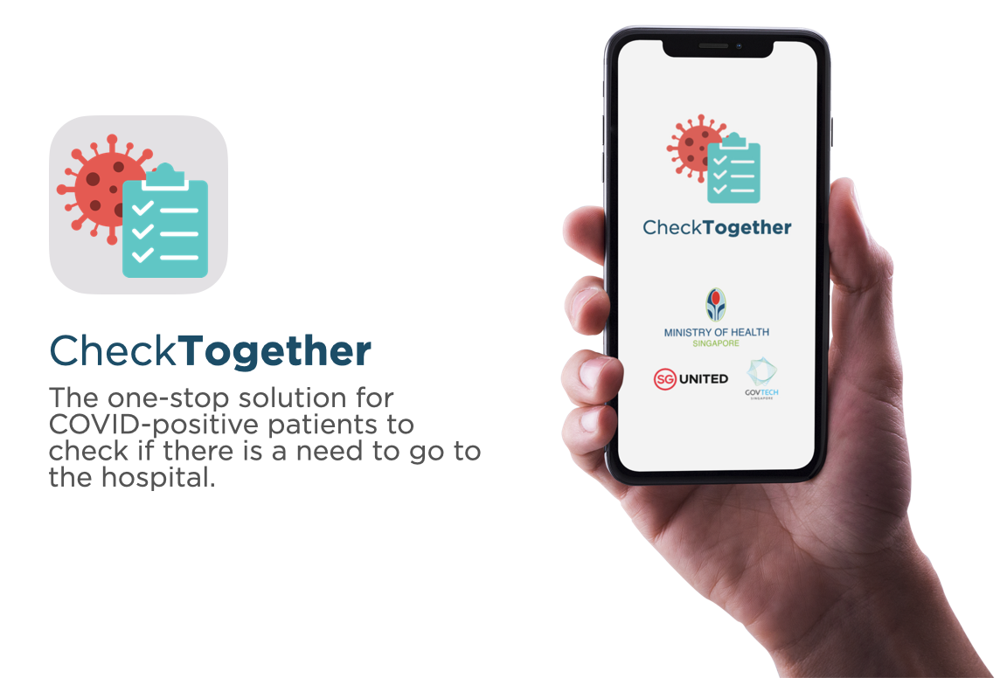
OUR SOLUTION
YI XUAN
SEVERITY PREDICTION MODEL
BUSINESS PROBLEM
OUR
SOLUTION
SEVERITY
PREDICTION
MODEL
ICU ADMISSION MODEL
MINISTRY OF HEALTH
SINGAPORE
EC1B24
F25F66
F68D92
221E20
777676
D8D8D8
Notes:
Without a doubt, we are currently living through extraordinary times. COVID-19 has plagued our world for nearly 2 years - earning it the title as the most serious global crisis in the last 75 years due to its wide ranging impacts and repercussions.

Slide 21
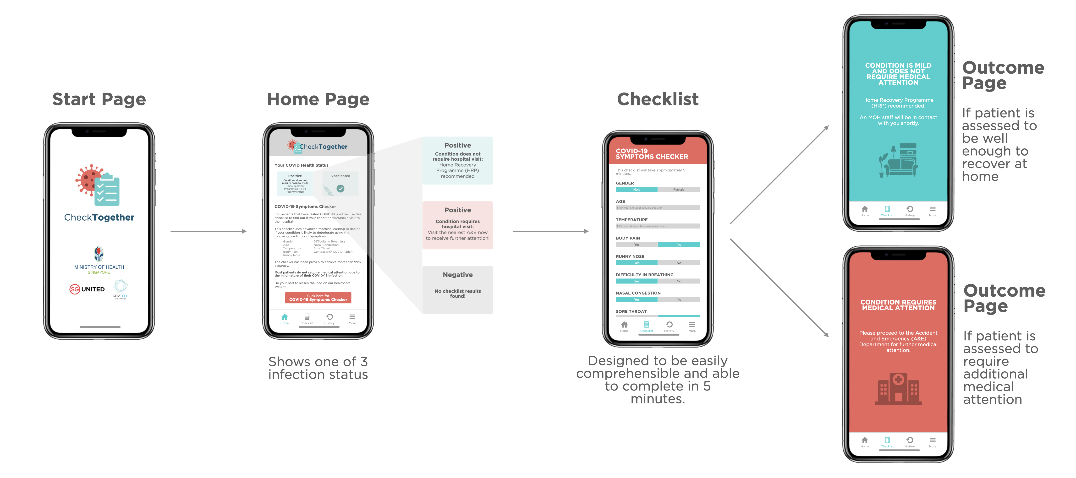
OUR SOLUTION
YI XUAN
SEVERITY PREDICTION MODEL
BUSINESS PROBLEM
OUR
SOLUTION
SEVERITY
PREDICTION
MODEL
ICU ADMISSION MODEL
MINISTRY OF HEALTH
SINGAPORE
EC1B24
F25F66
F68D92
221E20
777676
D8D8D8
Notes:
Without a doubt, we are currently living through extraordinary times. COVID-19 has plagued our world for nearly 2 years - earning it the title as the most serious global crisis in the last 75 years due to its wide ranging impacts and repercussions.

Slide 22
OUR SOLUTION
YI XUAN
SEVERITY PREDICTION MODEL
BUSINESS PROBLEM
OUR
SOLUTION
SEVERITY
PREDICTION
MODEL
ICU ADMISSION MODEL
MINISTRY OF HEALTH
SINGAPORE
EC1B24
F25F66
F68D92
221E20
777676
D8D8D8
Notes:
Without a doubt, we are currently living through extraordinary times. COVID-19 has plagued our world for nearly 2 years - earning it the title as the most serious global crisis in the last 75 years due to its wide ranging impacts and repercussions.

Slide 23
OUR SOLUTION
YI XUAN
APPROACH
BUSINESS PROBLEM
OUR
SOLUTION
SEVERITY
PREDICTION
MODEL
ICU ADMISSION MODEL
MINISTRY OF HEALTH
SINGAPORE
EC1B24
F25F66
F68D92
221E20
777676
D8D8D8
Notes:
Without a doubt, we are currently living through extraordinary times. COVID-19 has plagued our world for nearly 2 years - earning it the title as the most serious global crisis in the last 75 years due to its wide ranging impacts and repercussions.

Slide 24
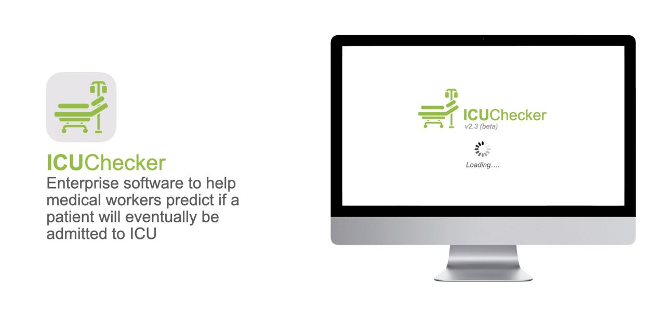
OUR SOLUTION
YI XUAN
ICU ADMISSION MODEL
BUSINESS PROBLEM
OUR
SOLUTION
SEVERITY
PREDICTION
MODEL
ICU ADMISSION MODEL
MINISTRY OF HEALTH
SINGAPORE
EC1B24
F25F66
F68D92
221E20
777676
D8D8D8
Notes:
Without a doubt, we are currently living through extraordinary times. COVID-19 has plagued our world for nearly 2 years - earning it the title as the most serious global crisis in the last 75 years due to its wide ranging impacts and repercussions.

Slide 25
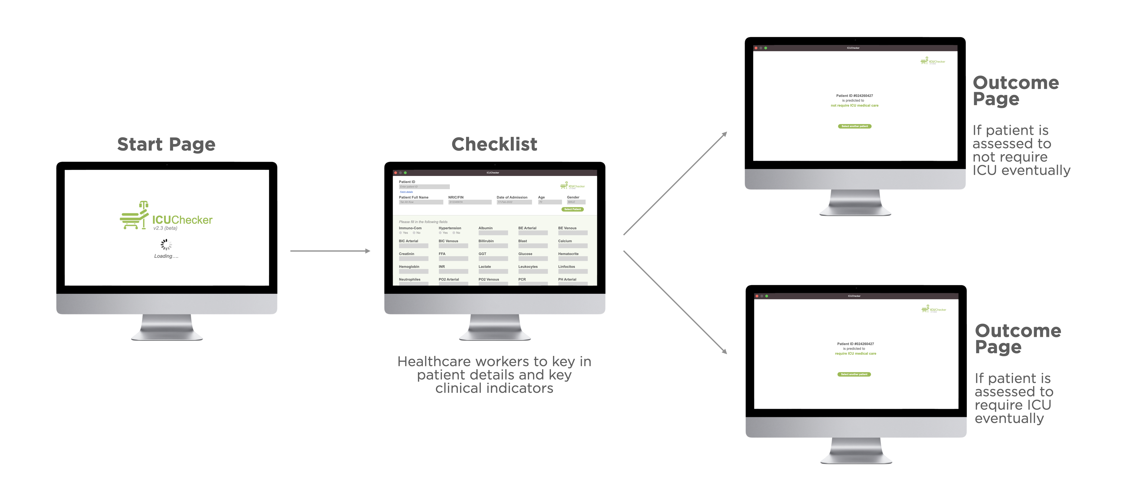
OUR SOLUTION
YI XUAN
ICU ADMISSION MODEL
BUSINESS PROBLEM
OUR
SOLUTION
SEVERITY
PREDICTION
MODEL
ICU ADMISSION MODEL
MINISTRY OF HEALTH
SINGAPORE
EC1B24
F25F66
F68D92
221E20
777676
D8D8D8
Notes:
Without a doubt, we are currently living through extraordinary times. COVID-19 has plagued our world for nearly 2 years - earning it the title as the most serious global crisis in the last 75 years due to its wide ranging impacts and repercussions.

Slide 26
OUR SOLUTION
YI XUAN
ICU ADMISSION MODEL
BUSINESS PROBLEM
OUR
SOLUTION
SEVERITY
PREDICTION
MODEL
ICU ADMISSION MODEL
MINISTRY OF HEALTH
SINGAPORE
EC1B24
F25F66
F68D92
221E20
777676
D8D8D8
Notes:
Without a doubt, we are currently living through extraordinary times. COVID-19 has plagued our world for nearly 2 years - earning it the title as the most serious global crisis in the last 75 years due to its wide ranging impacts and repercussions.

Slide 27
OUR SOLUTION
YI XUAN
PATIENT ROADMAP (BEFORE)
BUSINESS PROBLEM
OUR
SOLUTION
SEVERITY
PREDICTION
MODEL
ICU ADMISSION MODEL
MINISTRY OF HEALTH
SINGAPORE

Slide 28
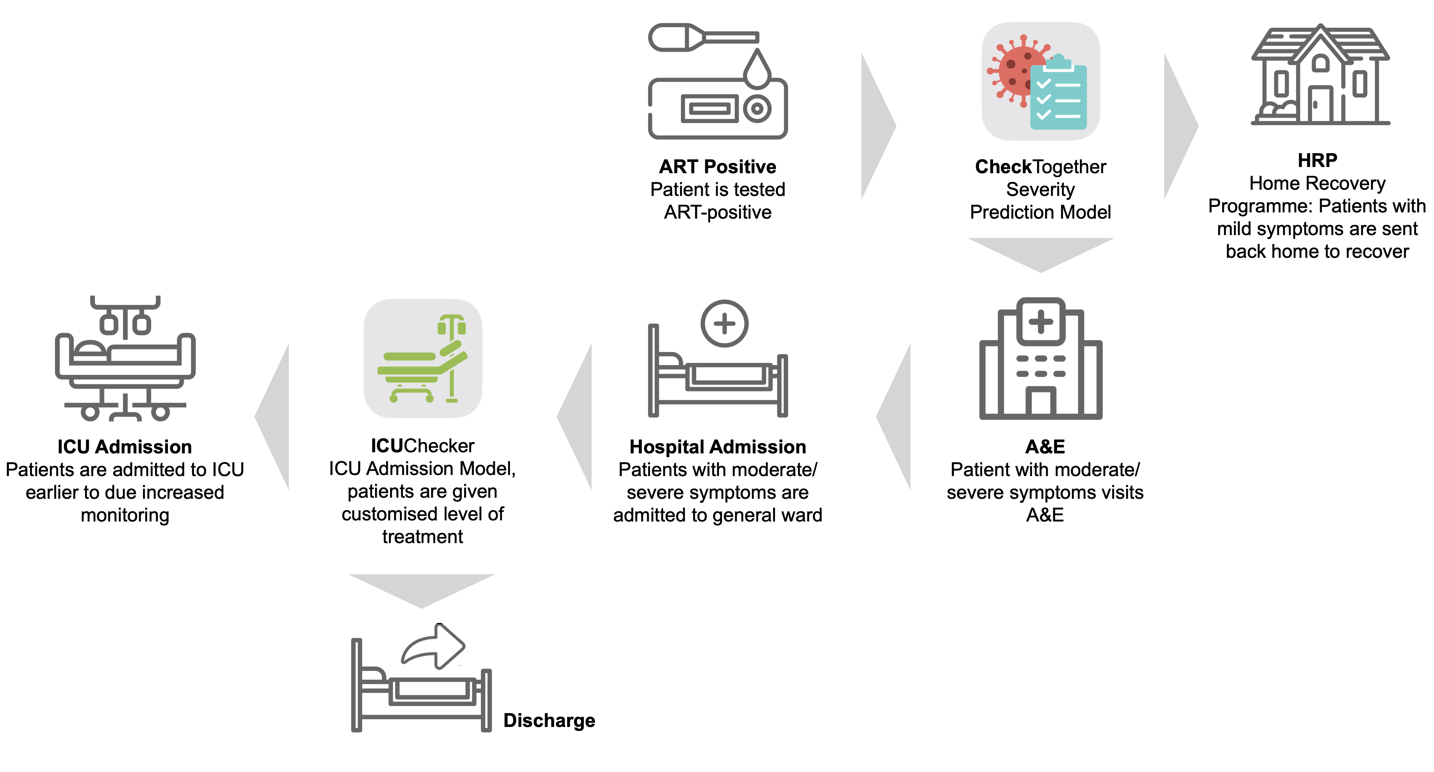
OUR SOLUTION
YI XUAN
PATIENT ROADMAP (AFTER)
BUSINESS PROBLEM
OUR
SOLUTION
SEVERITY
PREDICTION
MODEL
ICU ADMISSION MODEL
MINISTRY OF HEALTH
SINGAPORE

Slide 29
OUR SOLUTION
YI XUAN
PATIENT ROADMAP (AFTER)
BUSINESS PROBLEM
OUR
SOLUTION
SEVERITY
PREDICTION
MODEL
ICU ADMISSION MODEL
MINISTRY OF HEALTH
SINGAPORE

Slide 30
OUR SOLUTION
YI XUAN
PATIENT ROADMAP (AFTER)
BUSINESS PROBLEM
OUR
SOLUTION
SEVERITY
PREDICTION
MODEL
ICU ADMISSION MODEL
MINISTRY OF HEALTH
SINGAPORE

Slide 31
OUR SOLUTION
YI XUAN
RELEVANCE BEYOND COVID
BUSINESS PROBLEM
COVID-19 will not be the last pandemic that will hit the world
Governments should start preparing for the pandemic
Our solution could be quickly applied to future pandemics after sufficient data is made available
OUR
SOLUTION
SEVERITY
PREDICTION
MODEL
ICU ADMISSION MODEL
(Woon, 2022)
MINISTRY OF HEALTH
SINGAPORE
Notes:
Even though the models that we are proposing are targeted at the current pandemic, it is still relevant even as Singapore transitions to living with COVID-19 and the strain on hospital resources is relaxed. COVID-19 will not be the last pandemic that will hit the world and experts are calling on governments to start preparing for the next pandemic (Plump, 2021). Hence, the models could be quickly applied to future pandemics after sufficient data is made available.

Slide 32
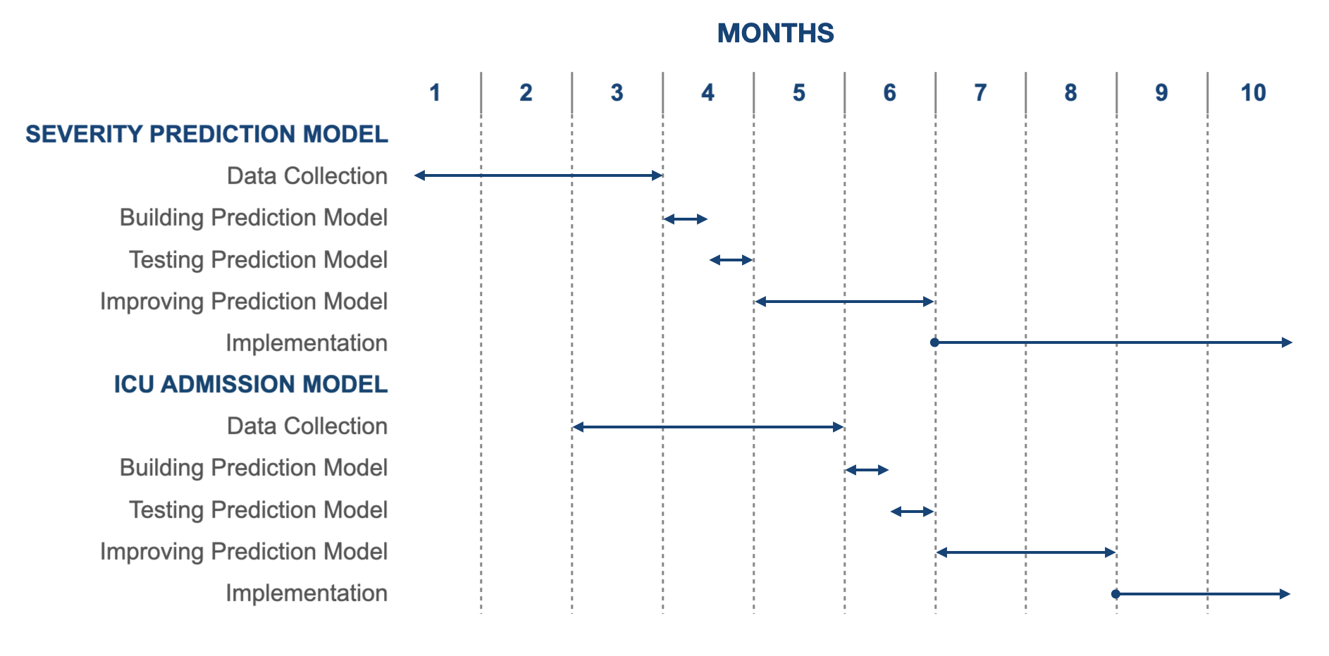
OUR SOLUTION
YI XUAN
IMPLEMENTATION TIMELINE
BUSINESS PROBLEM
OUR
SOLUTION
SEVERITY
PREDICTION
MODEL
ICU ADMISSION MODEL
MINISTRY OF HEALTH
SINGAPORE

Slide 33

OUR SOLUTION
JORDAN
BUSINESS PROBLEM
OUR
SOLUTION
SEVERITY
PREDICTION
MODEL
MACHINE LEARNING
ICU ADMISSION MODEL
MINISTRY OF HEALTH
SINGAPORE

Slide 34
OUR SOLUTION
JORDAN
ADVANTAGES OF ML
BUSINESS PROBLEM
Speed of Processing
Speed of developing a prediction model using machine learning would be a lot quicker than that of manual manipulation using traditional methods
Number Variables that can be Considered
Machine Learning can combine different learning algorithms to evaluate millions of information using limitless amounts of factors
OUR
SOLUTION
SEVERITY
PREDICTION
MODEL
ICU ADMISSION MODEL
MINISTRY OF HEALTH
SINGAPORE

Slide 35
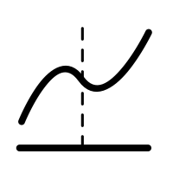

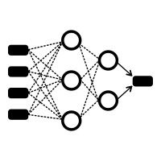
OUR SOLUTION
JORDAN
ML TECHNIQUES
BUSINESS PROBLEM
OUR
SOLUTION
SEVERITY
PREDICTION
MODEL
Logistic
Regression
Random
Forest
Neural
Network
ICU ADMISSION MODEL
MINISTRY OF HEALTH
SINGAPORE

Slide 36
OUR SOLUTION
JORDAN
ML TECHNIQUES
BUSINESS PROBLEM
OUR
SOLUTION
Statistical analysis method to predict a binary outcome, such as yes or no, based on prior observations of a data set
Predicts a dependent data variable by analysing the relationship between one or more existing independent variables
SEVERITY
PREDICTION
MODEL
Logistic
Regression
ICU ADMISSION MODEL
(Lawton et al., n.d.)
MINISTRY OF HEALTH
SINGAPORE
Notes:
https://www.techtarget.com/searchbusinessanalytics/definition/logistic-regression

Slide 37
OUR SOLUTION
JORDAN
ML TECHNIQUES
BUSINESS PROBLEM
OUR
SOLUTION
A decision tree is a flowchart-like diagram that maps the possible outcomes of a series of related choices
Random forest combines many decision trees into a single model whereby predictions are closer to the mark on average
(Lucidchart, n.d.)
SEVERITY
PREDICTION
MODEL
Random
Forest
ICU ADMISSION MODEL
(Koehrsen, 2017)
MINISTRY OF HEALTH
SINGAPORE
Notes:
https://www.techtarget.com/searchbusinessanalytics/definition/logistic-regression
https://williamkoehrsen.medium.com/random-forest-simple-explanation-377895a60d2d

Slide 38
OUR SOLUTION
JORDAN
ML TECHNIQUES
BUSINESS PROBLEM
OUR
SOLUTION
A series of algorithms to recognise underlying relationships in a set of data through a process that mimics the way the human brain operates
Artificial neural networks resemble the connections of neurons and synapses found in the brain
SEVERITY
PREDICTION
MODEL
Neural
Network
(Chen, 2021)
ICU ADMISSION MODEL
MINISTRY OF HEALTH
SINGAPORE
Notes:
https://www.techtarget.com/searchbusinessanalytics/definition/logistic-regression
https://williamkoehrsen.medium.com/random-forest-simple-explanation-377895a60d2d

Slide 39
SEVERITY PREDICTION MODEL
JORDAN
DATASET
BUSINESS PROBLEM
Data is a sourced from Github’s repository
Contains demographic and symptoms data of patients diagnosed with COVID-19
Outcome Variable: Severity
Mild, Moderate, Severe
2500 unique observations, 11 characteristics
OUR
SOLUTION
SEVERITY
PREDICTION
MODEL
ICU ADMISSION MODEL
MINISTRY OF HEALTH
SINGAPORE
Notes:
Without a doubt, we are currently living through extraordinary times. COVID-19 has plagued our world for nearly 2 years - earning it the title as the most serious global crisis in the last 75 years due to its wide ranging impacts and repercussions.

Slide 40
SEVERITY PREDICTION MODEL
JORDAN
DATASET
BUSINESS PROBLEM
Age
Difficulty in Breathing
OUR
SOLUTION
Gender
Nasal Congestion
SEVERITY
PREDICTION
MODEL
Temperature
Sore Throat
Body Pain
Contact with COVID Patient
ICU ADMISSION MODEL
Runny Nose
MINISTRY OF HEALTH
SINGAPORE
Notes:
Without a doubt, we are currently living through extraordinary times. COVID-19 has plagued our world for nearly 2 years - earning it the title as the most serious global crisis in the last 75 years due to its wide ranging impacts and repercussions.

Slide 41
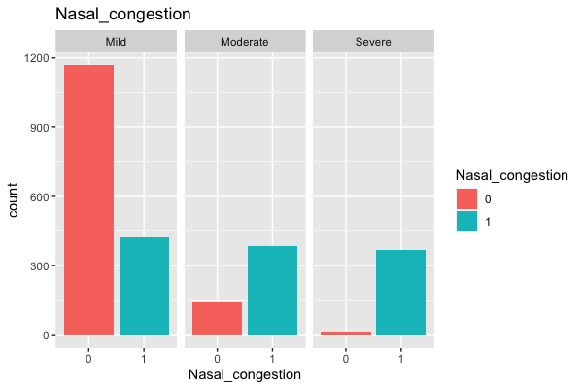
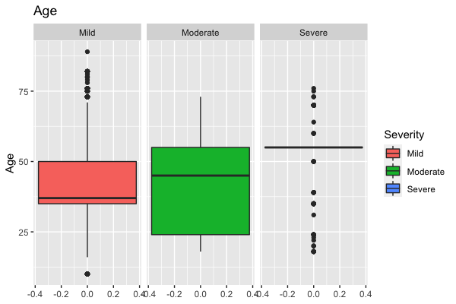
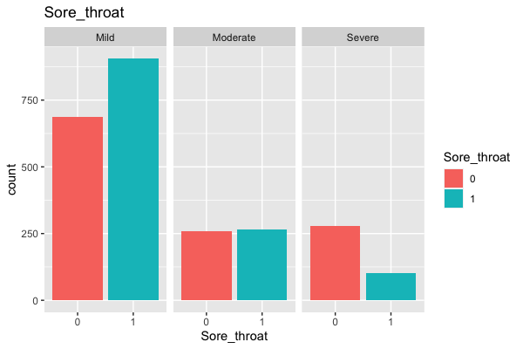
SEVERITY PREDICTION MODEL
JORDAN
DATA EXPLORATION
BUSINESS PROBLEM
OUR
SOLUTION
SEVERITY
PREDICTION
MODEL
ICU ADMISSION MODEL
MINISTRY OF HEALTH
SINGAPORE
Notes:
Without a doubt, we are currently living through extraordinary times. COVID-19 has plagued our world for nearly 2 years - earning it the title as the most serious global crisis in the last 75 years due to its wide ranging impacts and repercussions.

Slide 42
SEVERITY PREDICTION MODEL
JORDAN
DATA CLEANING
BUSINESS PROBLEM
Dataset is complete and does not have any null values
Cleaning Data:
Country variable was dropped
Temperature was converted to degrees Fahrenheit to degrees Celsius.
The Contact_with_covid_patient variable had 2 responses that had the same significance: ‘Yes’ and ‘yes’. Rows with ‘yes’ were converted to ‘Yes’
OUR
SOLUTION
SEVERITY
PREDICTION
MODEL
ICU ADMISSION MODEL
MINISTRY OF HEALTH
SINGAPORE
Notes:
Without a doubt, we are currently living through extraordinary times. COVID-19 has plagued our world for nearly 2 years - earning it the title as the most serious global crisis in the last 75 years due to its wide ranging impacts and repercussions.

Slide 43
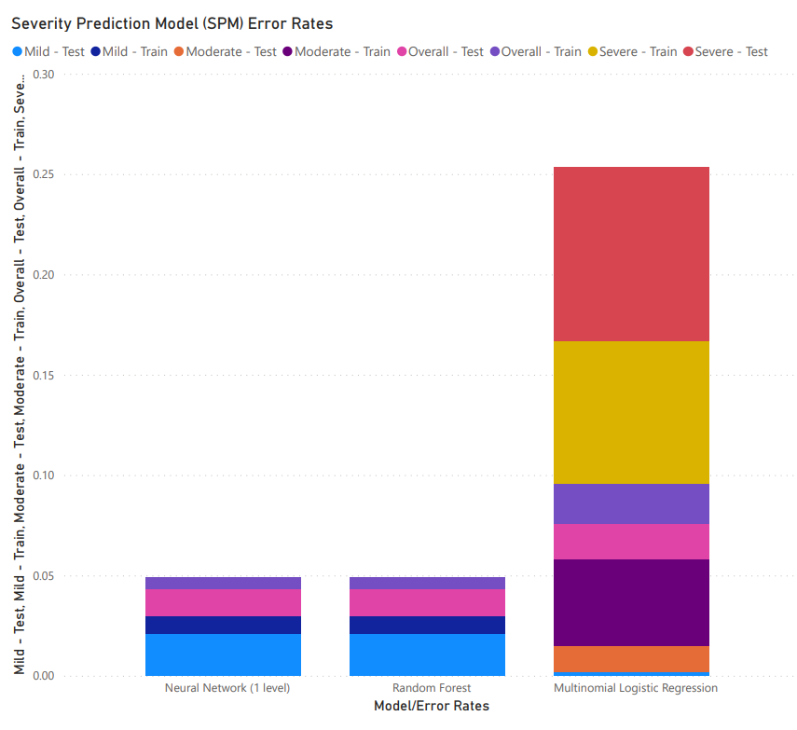
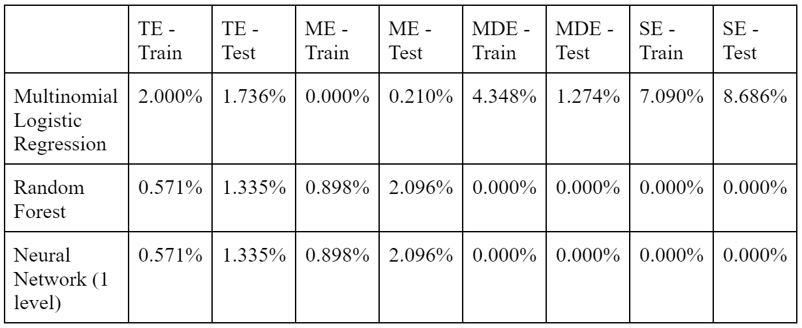
SEVERITY PREDICTION MODEL
JORDAN
MODEL COMPARISON
BUSINESS PROBLEM
OUR
SOLUTION
TE: Total Error
ME: Mild Error
MDE: Moderate Error
SE: Severe Error
SEVERITY
PREDICTION
MODEL
ICU ADMISSION MODEL
MINISTRY OF HEALTH
SINGAPORE
Notes:
Without a doubt, we are currently living through extraordinary times. COVID-19 has plagued our world for nearly 2 years - earning it the title as the most serious global crisis in the last 75 years due to its wide ranging impacts and repercussions.

Slide 44
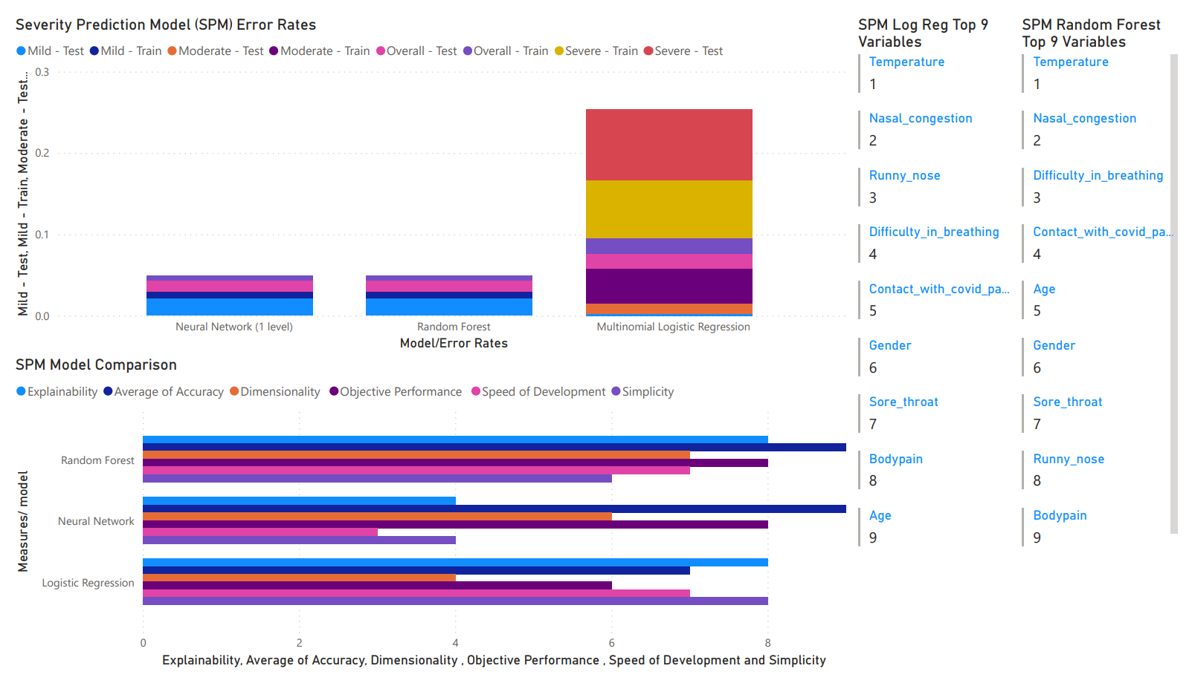
SEVERITY PREDICTION MODEL
JORDAN
MODEL COMPARISON
BUSINESS PROBLEM
Random Forest
Explainability
Accuracy
Dimensionality
Objective Performance
Speed of Development
OUR
SOLUTION
SEVERITY
PREDICTION
MODEL
ICU ADMISSION MODEL
MINISTRY OF HEALTH
SINGAPORE
Notes:
Without a doubt, we are currently living through extraordinary times. COVID-19 has plagued our world for nearly 2 years - earning it the title as the most serious global crisis in the last 75 years due to its wide ranging impacts and repercussions.

Slide 45
ICU ADMISSION MODEL
TERESA
DATASET
BUSINESS PROBLEM
Data is a sourced from Kaggle
Contains clinical data of patients diagnosed with COVID-19
Each patient has 5 rows of data for readings taken at 5 different windows
OUR
SOLUTION
SEVERITY
PREDICTION
MODEL
ICU ADMISSION MODEL
MINISTRY OF HEALTH
SINGAPORE
EC1B24
F25F66
F68D92
221E20
777676
D8D8D8
Notes:
Without a doubt, we are currently living through extraordinary times. COVID-19 has plagued our world for nearly 2 years - earning it the title as the most serious global crisis in the last 75 years due to its wide ranging impacts and repercussions.

Slide 46
ICU ADMISSION MODEL
TERESA
DATASET
BUSINESS PROBLEM
Outcome Variable: ICU
0: Patient not admitted to ICU
1: Patient admitted to ICU
1424 unique observations, 48 characteristics
OUR
SOLUTION
SEVERITY
PREDICTION
MODEL
ICU ADMISSION MODEL
MINISTRY OF HEALTH
SINGAPORE
EC1B24
F25F66
F68D92
221E20
777676
D8D8D8
Notes:
Without a doubt, we are currently living through extraordinary times. COVID-19 has plagued our world for nearly 2 years - earning it the title as the most serious global crisis in the last 75 years due to its wide ranging impacts and repercussions.

Slide 47
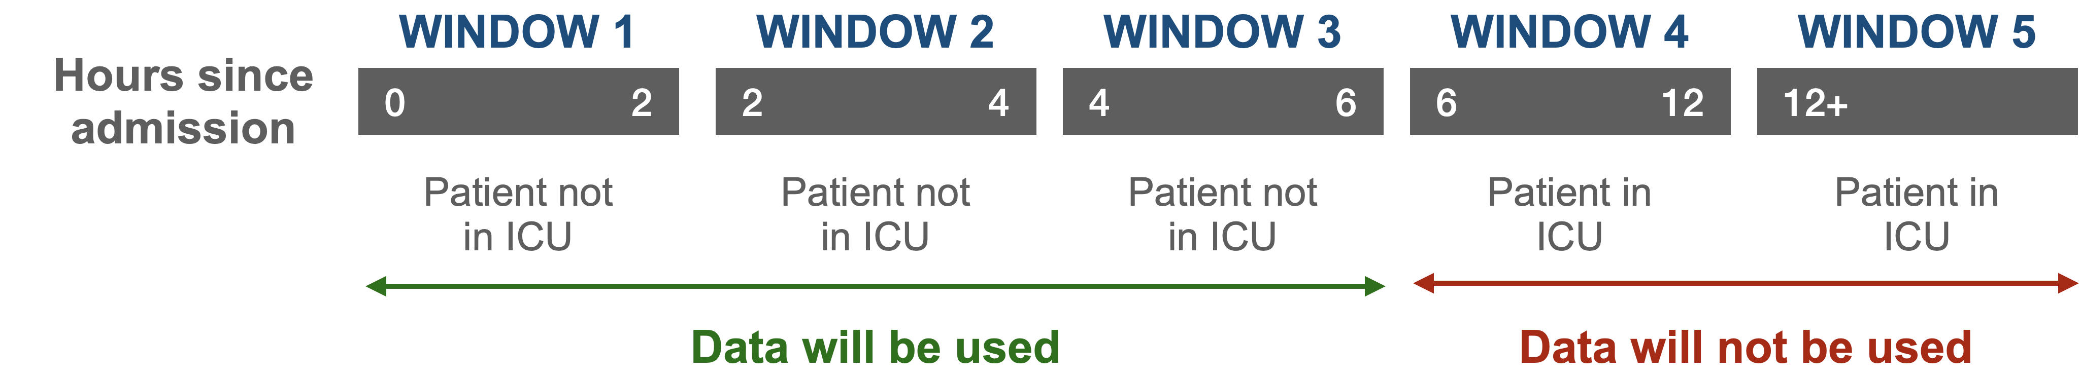
ICU ADMISSION MODEL
TERESA
DATA CLEANING
BUSINESS PROBLEM
OUR
SOLUTION
SEVERITY
PREDICTION
MODEL
ICU ADMISSION MODEL
MINISTRY OF HEALTH
SINGAPORE
EC1B24
F25F66
F68D92
221E20
777676
D8D8D8
Notes:
As our model predicts whether the patient will eventually end up in ICU, clinical data taken when the patient is already in ICU is not meaningful. Hence, the windows in which patients are already admitted into ICU will not be used in our data modelling and would be discarded instead.

Slide 48
ICU ADMISSION MODEL
TERESA
DATA CLEANING
BUSINESS PROBLEM
OUR
SOLUTION
SEVERITY
PREDICTION
MODEL
Observations with ICU = 1 are dropped
Redefinition of Outcome Variable
0: Patients not admitted to ICU
1: Patients just about to be admitted to ICU (1 window before patient is in ICU)
ICU ADMISSION MODEL
MINISTRY OF HEALTH
SINGAPORE
EC1B24
F25F66
F68D92
221E20
777676
D8D8D8
Notes:
As our model predicts whether the patient will eventually end up in ICU, clinical data taken when the patient is already in ICU is not meaningful. Hence, the windows in which patients are already admitted into ICU will not be used in our data modelling and would be discarded instead.

Slide 49

ICU ADMISSION MODEL
TERESA
DATA CLEANING
BUSINESS PROBLEM
Missing Values Handling
Used ‘rflmpute()’ to replace all NA values
OUR
SOLUTION
SEVERITY
PREDICTION
MODEL
ICU ADMISSION MODEL
MINISTRY OF HEALTH
SINGAPORE
EC1B24
F25F66
F68D92
221E20
777676
D8D8D8
Notes:
As our model predicts whether the patient will eventually end up in ICU, clinical data taken when the patient is already in ICU is not meaningful. Hence, the windows in which patients are already admitted into ICU will not be used in our data modelling and would be discarded instead.

Slide 50
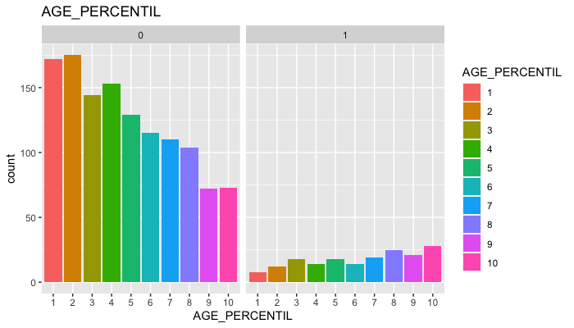


ICU ADMISSION MODEL
TERESA
DATA EXPLORATION
BUSINESS PROBLEM
Age Percentile
OUR
SOLUTION
SEVERITY
PREDICTION
MODEL
ICU ADMISSION MODEL
MINISTRY OF HEALTH
SINGAPORE
EC1B24
F25F66
F68D92
221E20
777676
D8D8D8

Slide 51

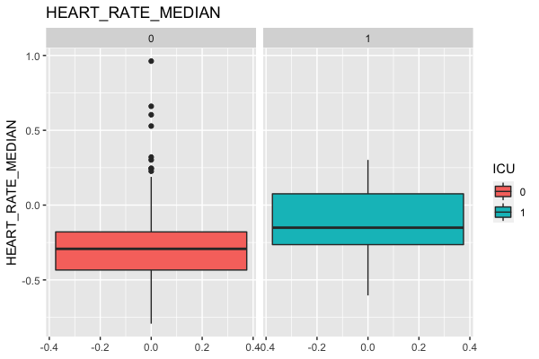
ICU ADMISSION MODEL
TERESA
DATA EXPLORATION
BUSINESS PROBLEM
Heart Rate
OUR
SOLUTION
SEVERITY
PREDICTION
MODEL
ICU ADMISSION MODEL
MINISTRY OF HEALTH
SINGAPORE
EC1B24
F25F66
F68D92
221E20
777676
D8D8D8

Slide 52

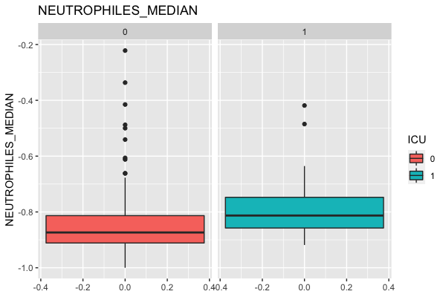
ICU ADMISSION MODEL
TERESA
DATA EXPLORATION
BUSINESS PROBLEM
Neutrophils
OUR
SOLUTION
SEVERITY
PREDICTION
MODEL
ICU ADMISSION MODEL
MINISTRY OF HEALTH
SINGAPORE
EC1B24
F25F66
F68D92
221E20
777676
D8D8D8

Slide 53

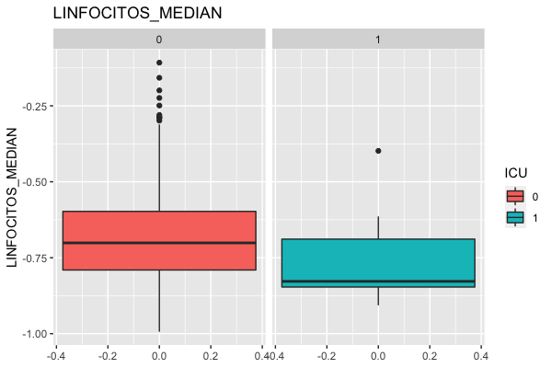
ICU ADMISSION MODEL
TERESA
DATA EXPLORATION
BUSINESS PROBLEM
Lymphocytes
OUR
SOLUTION
SEVERITY
PREDICTION
MODEL
ICU ADMISSION MODEL
MINISTRY OF HEALTH
SINGAPORE
EC1B24
F25F66
F68D92
221E20
777676
D8D8D8

Slide 54
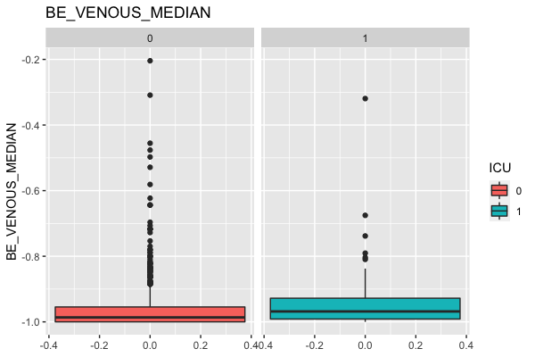
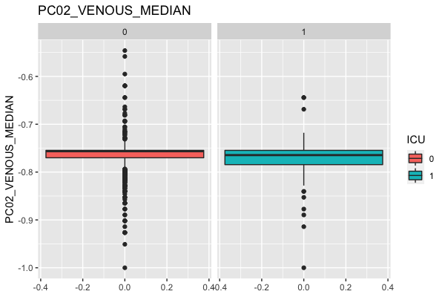
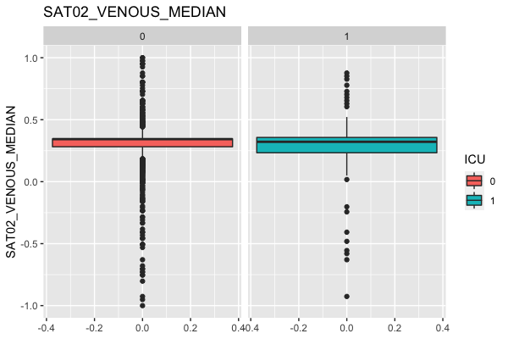
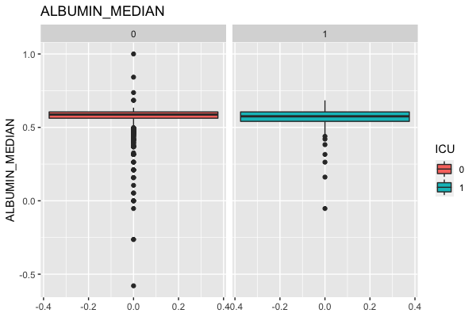
ICU ADMISSION MODEL
TERESA
DATA EXPLORATION
BUSINESS PROBLEM
All variables in general
OUR
SOLUTION
SEVERITY
PREDICTION
MODEL
ICU ADMISSION MODEL
MINISTRY OF HEALTH
SINGAPORE
EC1B24
F25F66
F68D92
221E20
777676
D8D8D8

Slide 55
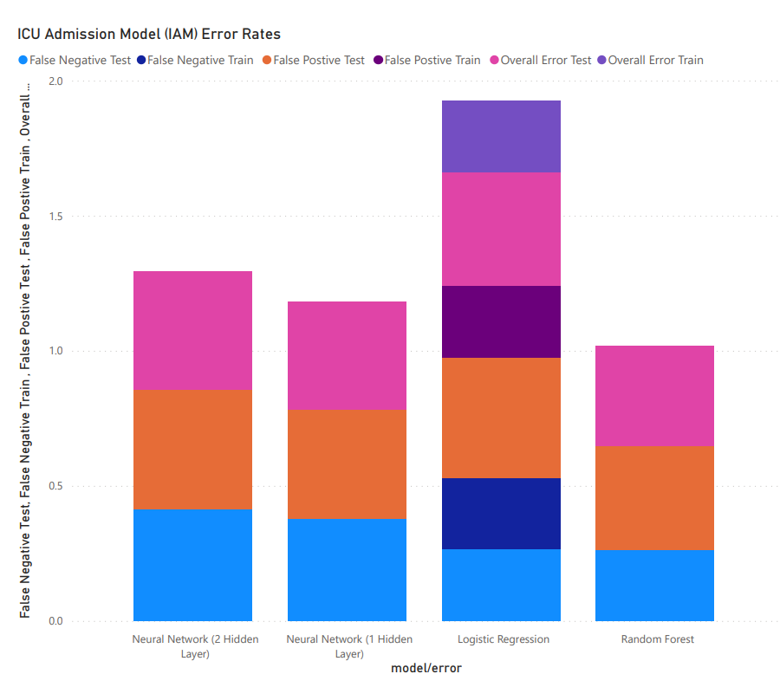
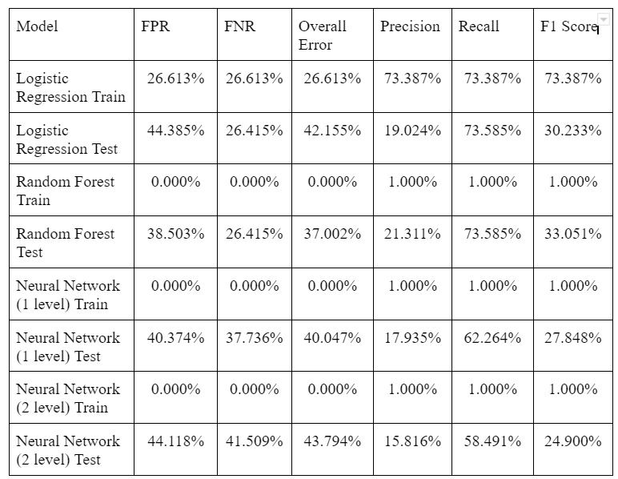
ICU ADMISSION MODEL
TERESA
MODEL COMPARISON
BUSINESS PROBLEM
OUR
SOLUTION
SEVERITY
PREDICTION
MODEL
ICU ADMISSION MODEL
MINISTRY OF HEALTH
SINGAPORE
EC1B24
F25F66
F68D92
221E20
777676
D8D8D8
Notes:
Without a doubt, we are currently living through extraordinary times. COVID-19 has plagued our world for nearly 2 years - earning it the title as the most serious global crisis in the last 75 years due to its wide ranging impacts and repercussions.

Slide 56
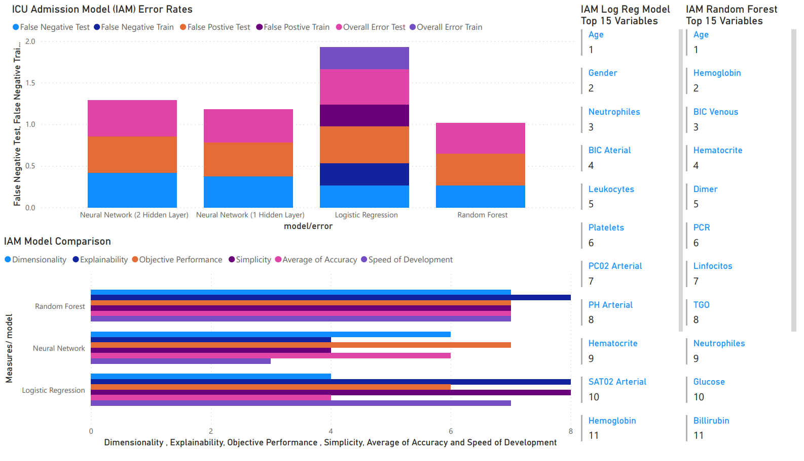
ICU ADMISSION MODEL
TERESA
Model Comparison
BUSINESS PROBLEM
Random Forest
Dimensionality
Explainability
Objective Performance
Accuracy
Speed of Development
OUR
SOLUTION
SEVERITY
PREDICTION
MODEL
ICU ADMISSION MODEL
MINISTRY OF HEALTH
SINGAPORE
EC1B24
F25F66
F68D92
221E20
777676
D8D8D8
Notes:
Without a doubt, we are currently living through extraordinary times. COVID-19 has plagued our world for nearly 2 years - earning it the title as the most serious global crisis in the last 75 years due to its wide ranging impacts and repercussions.

Slide 57
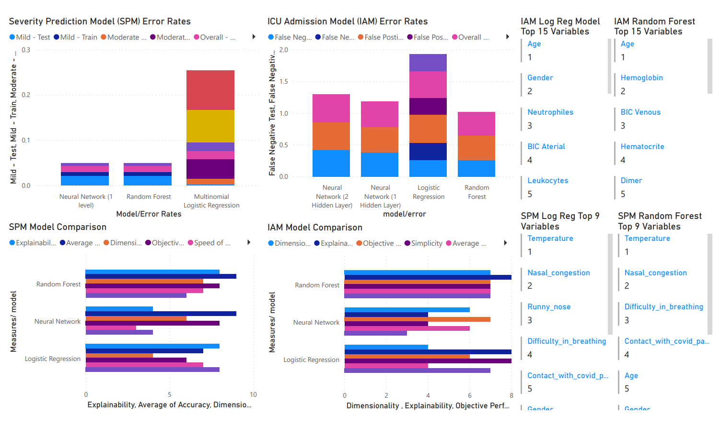
CONCLUSION
TERESA
VISUALISATION
BUSINESS PROBLEM
OUR
SOLUTION
SEVERITY
PREDICTION
MODEL
ICU ADMISSION MODEL
MINISTRY OF HEALTH
SINGAPORE
EC1B24
F25F66
F68D92
221E20
777676
D8D8D8
Notes:
Without a doubt, we are currently living through extraordinary times. COVID-19 has plagued our world for nearly 2 years - earning it the title as the most serious global crisis in the last 75 years due to its wide ranging impacts and repercussions.

Slide 58
CONCLUSION
TERESA
Concluding statements
BUSINESS PROBLEM
How our Models can help:
Severity Prediction Model
98.7% accuracy, 100% for Moderate and Severe cases.
Mild cases of 63.6% advised to stay at home instead of visiting a hospital = Reduction in patients who visit the A&E
ICU Admission Model
73.6% Recall percentage (accurately predicted)
Hospitals can therefore prevent deterioration of the patient's condition before need for ICU care
OUR
SOLUTION
SEVERITY
PREDICTION
MODEL
ICU ADMISSION MODEL
MINISTRY OF HEALTH
SINGAPORE
EC1B24
F25F66
F68D92
221E20
777676
D8D8D8

Slide 59

CONCLUSION
TERESA
FUTURE PANDEMICS
BUSINESS PROBLEM
OUR
SOLUTION
SEVERITY
PREDICTION
MODEL
ICU ADMISSION MODEL
MINISTRY OF HEALTH
SINGAPORE
EC1B24
F25F66
F68D92
221E20
777676
D8D8D8

Slide 60
THANK YOU
OPTIMISING HEALTHCARE RESOURCES WITH MACHINE LEARNING
MINISTRY OF HEALTH
SINGAPORE

